Slide 1
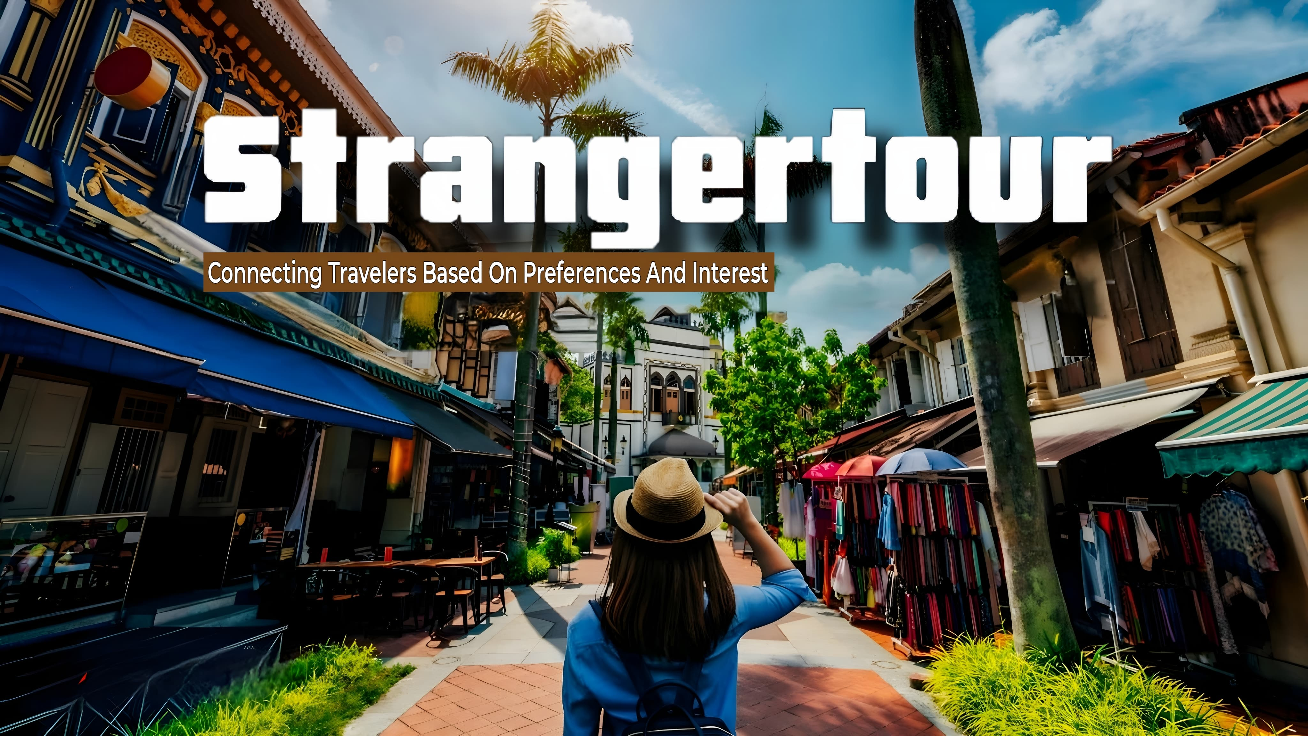


Slide 2

Introduction
02
Introduction to the Strangertour platform :
A platform where users can join communities of travelers with similar preferences.
Goal : To help people find random but compatible travel companions.
Core Feature : An algorithm that matches users based on travel preferences and availability.

Slide 3
03
Problem
The three main reason why trips often get cancelled are:
Problem 1
Problem 2
Problem 3
Scheduling Conflicts : Its difficult to align everyone’s availability due to varying work, personal commitments, or life events. (in easy words its hard to find a time when everyone is free)
Budget Issues : Financial constraints can come up for some members of the group, making it difficult for everyone to commit to the cost of travel, accommodation, and activities.
Lack Of Friends : Lack of friends on a tour can lead to higher costs, less fun, safety concerns, loneliness, and missed group discounts.

Slide 4

Solution
04
In one solution
We know that in today’s generation how difficult it is for plan a single trip with your friends that’s why we will provide a platform through which you can make strangers to friends according to your compatibility or according to your mind set and you can plan a trip with them and enjoy your trips with your stranger friends and create memories.

Slide 5
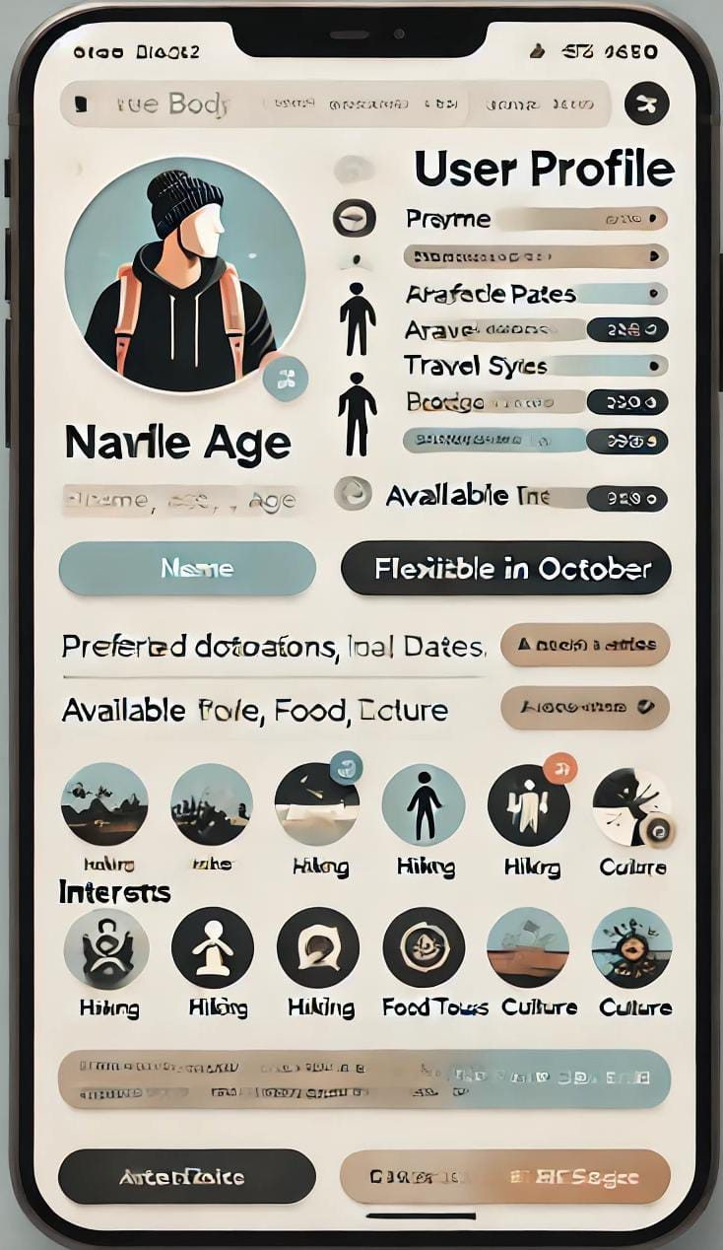


How ?
Users Profile setup with demographic information
Travel Preferences
Preferences For Travel Companions
This data feeds into the matchmaking algorithm and making groups.
Destination of interest
Budget Range
Travel Dates & Flexibility
Types of Trips
Group Size
Gender Preference
Age Range
Activity Levels

Slide 6

The Matching Algorithm
Clustering
Group travelers based on destinations and travel styles.
Time Matching
The core Algorithm : How it Matching Users.
Finds users with overlapping or flexible travel dates.
Weighting System
Assigns importance to different criteria (e.g., budget, interests, reviews).

Slide 7
Ensuring Safety and Trust
07
01
02
03
04
Profile Verification
Users Ratings
Location monitoring
Reporting
Travelers rate each other after trips, and also vote one person to lead the group.
Group travelers location monitoring according to their preference for safety purpose
Social media or Aadhar Id.
Mechanisms to report and block problematic users

Slide 8
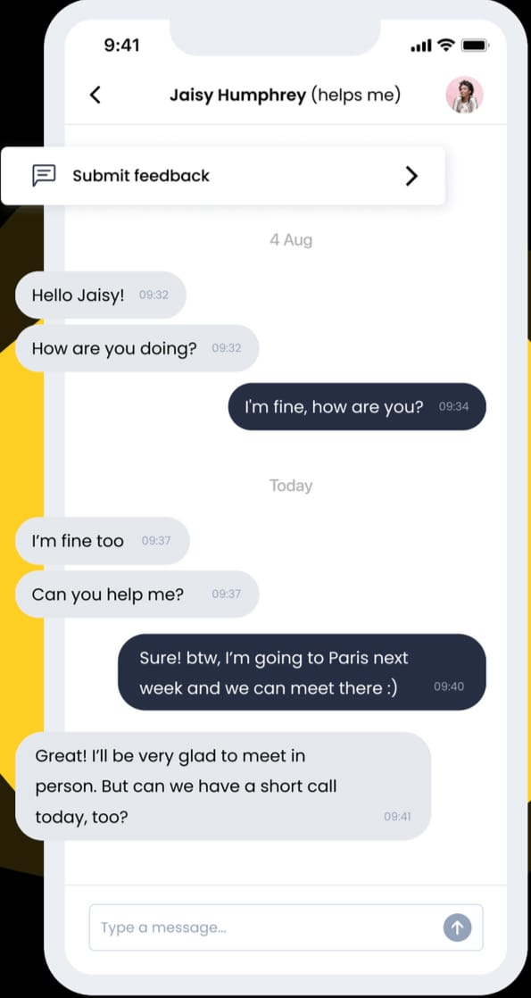

Interest-Based Communities
Create Travel Communities :
Users are placed into communities based on similar interests.
Communities have group chats where users can interact before the trip.
Communities are dynamic and update as new users join.

Slide 9
Future Features & Scalability
09
Point -1
Point- 3
AI-driven matching for even more personalized recommendations.
Integrate travel planning tools (Booking hotels, flights, etc )
Point - 2
Point - 4
Expansion to include more niche travel interests (e.g., Solo Female travelers , adventures sports, etc.)
Soon

Slide 10
Uniqueness
After a group has completed their travel, we will conduct a poll to identify the best-performing member of the group. The selected member will be appointed as the group’s Admin. As an admin, they can then manage the group, acting as a Tour Planner or Guide for future trips. The role will allow them to organize future tours and generate revenue through the platform with own travelling experience.

Slide 11
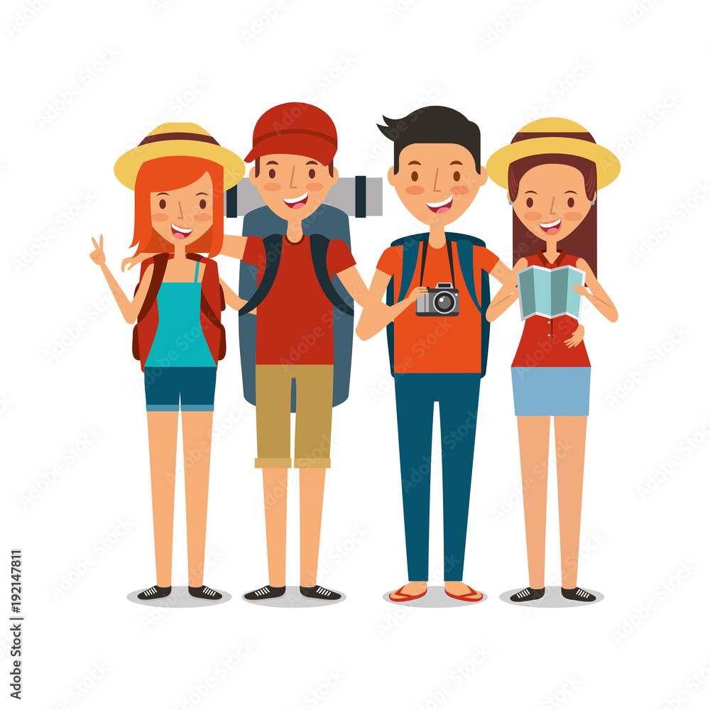
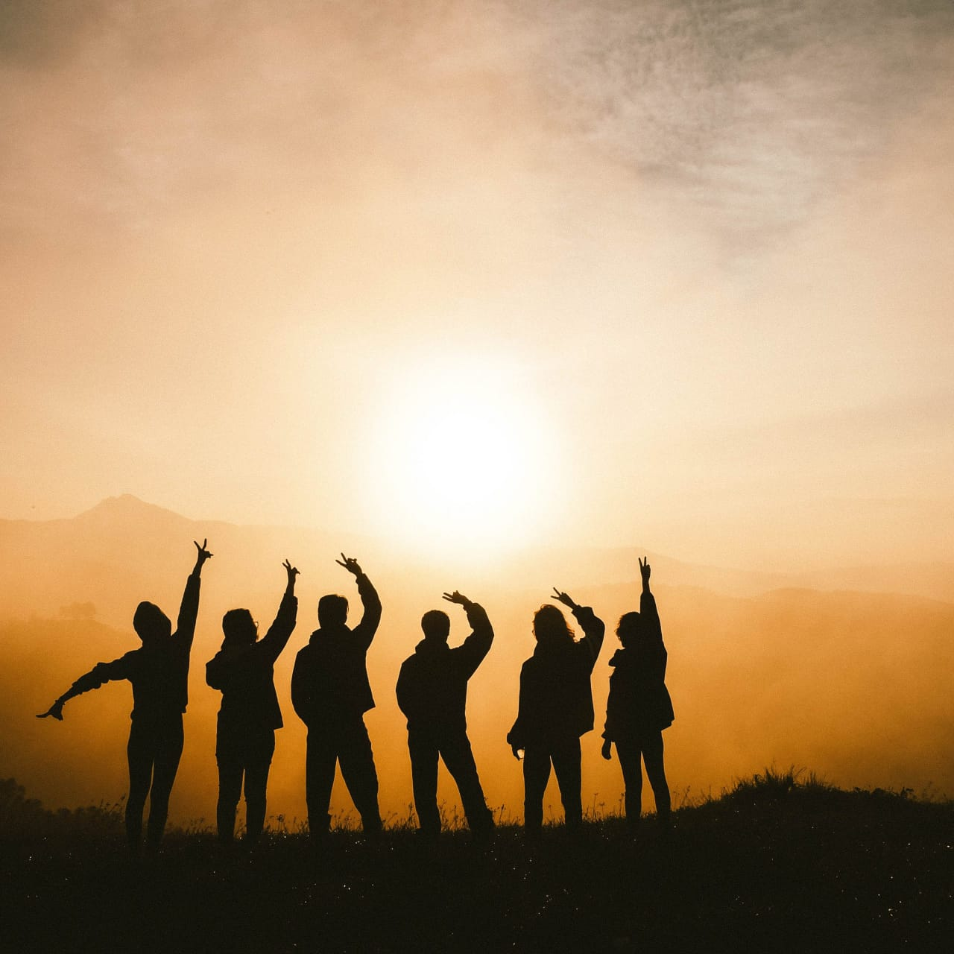
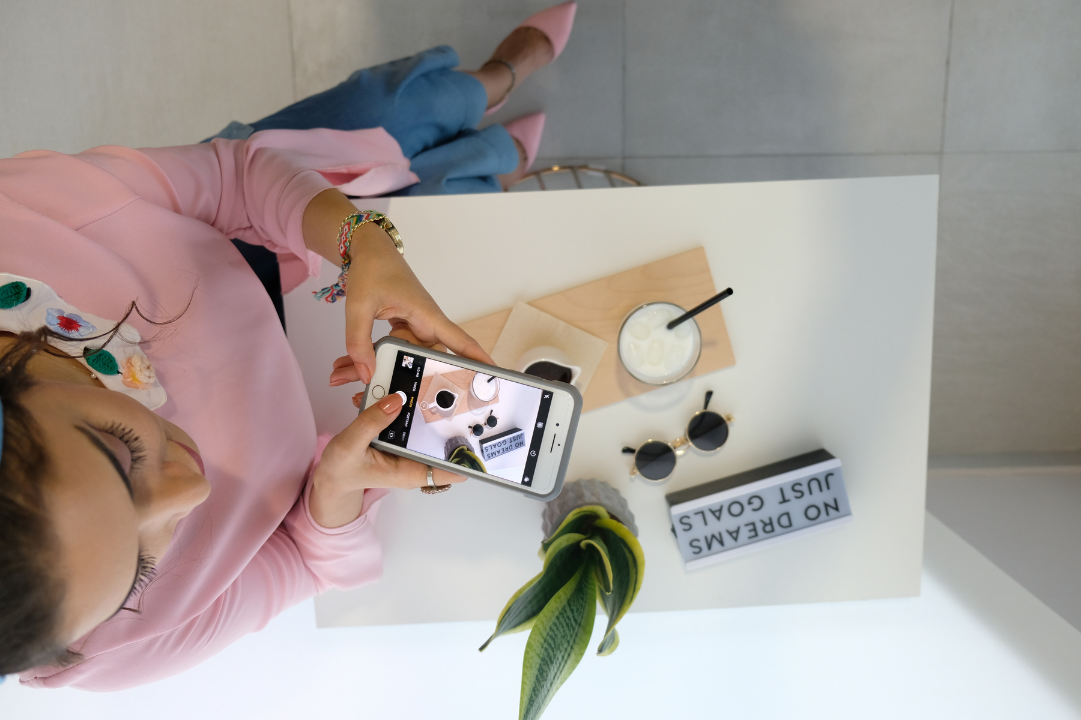


Benefits for travelers
Find like-minded travel companions.
Explore new destinations with others who share similar interests.
Improve travel experiences through better planning and coordination.

Slide 12


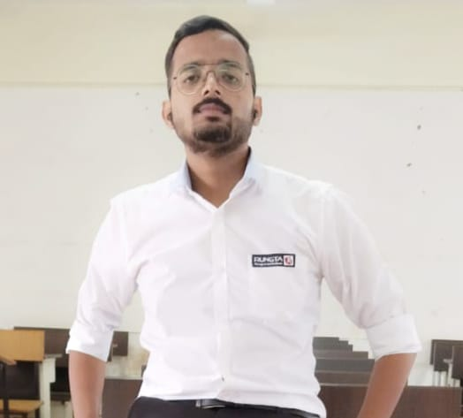


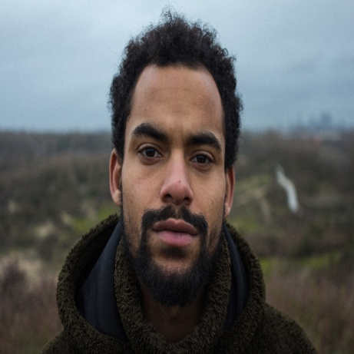
12
Shekhar Kumar
Founder
Gourav Kumar Ojha
Our teams
Co-Founder
?
Team-Member

Slide 13

Contact us
13
Email Address
shekharkumarsk2037@gmail.com
Phone Number
9199932316

